Slide 1
Comic-themed Toys Inventory Classification
For inventory management system
Notes:
good afternoon everyone
today I gonna present you guys about the development process of Comic-themed Toys Inventory Classification in order to enhance the inventory management system of our toy shop

Slide 2
TABLE OF CONTENTS
01
02
03
04
Problem statement & Objective
Methodology
Data collection & preprocess
Modeling & Evaluation
05
06
Error analysis
Conclusion & Recommendation
Notes:
And

Slide 3
01
Problem statement & Objective

Slide 4
Problem statement
Our toy shop specializes in selling a diverse range of comic-themed toys, including action figures, collectibles, and playsets inspired by popular characters from Marvel Comics and DC Comics. To enhance customer experience and streamline inventory management, you've decided to implement a classification model that can automatically categorize and label incoming comic-themed toys searching input from user which can be deployed in our product searching system.

Slide 5
Objective
To develop and deploy a classification model that accurately identifies whether a given comic-themed toy corresponds to Marvel Comics or DC Comics. The model should be integrated into the inventory management system of the toy shop to automate the classification process.
The model should achieve a high accuracy rate in classifying comic-themed toys into their respective Marvel or DC categories. The integration should result in a more efficient and accurate inventory management process, reducing manual effort and improving the overall user experience.

Slide 6
02
Methodology

Slide 7
Methodology
1
2
3
Data collection
Preprocessing Data
Encoding Data
6
5
4
Finetune
Evaluation
Modeling
Notes:
Our methodology is seperated into 6 parts during classification model development process
Which are
First
Second
Third
Fourth
Fifth
Sixth

Slide 8
03
Data collection & Preprocess

Slide 9
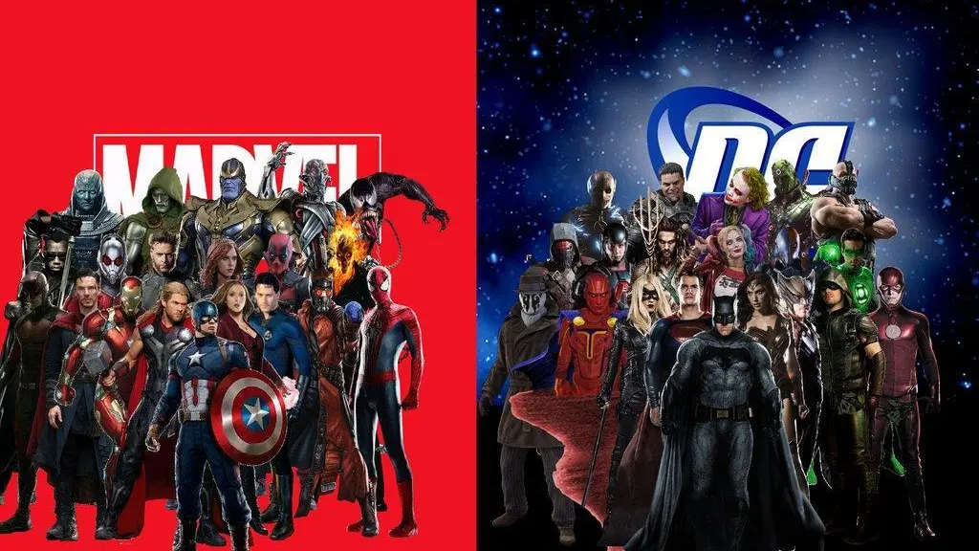
r/Marvel
r/DCcomics
1,995 posts
2,185 posts
Sub-reddit:
Marvel and DCcomics
Collected the Data by scrapping
data via reddit’s API
Notes:
the Data is collected by scrapping
data using the Python Reddit API
From sub reddit between Marvel and Dccomics
We’ve got 1995 posts of Marvel and 2185 posts of Dccomics
All together about 4100 posts

Slide 10
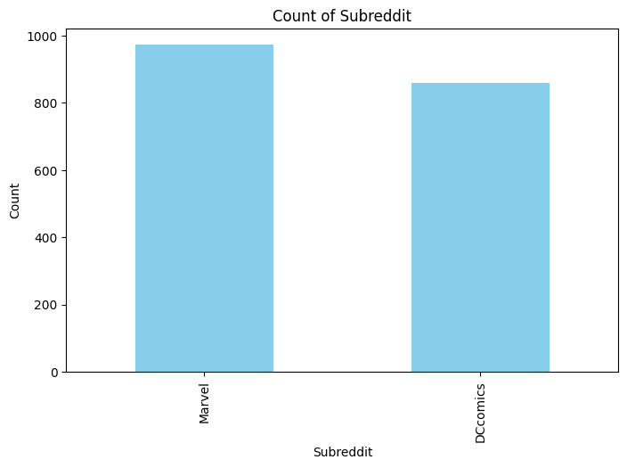
Data preprocessing
Remove duplicates
Before remove duplicates
Dccomics = 2,185
Marvel = 1,995
After remove duplicates
Dccomics = 861
Marvel = 973
Sample size = 1,834
Notes:
In the data preprocessing,
The duplicates posts were removed from these data
Which decrease data more over 50 percentage
The sample size of data is about 1,800 posts for training and testing model

Slide 11
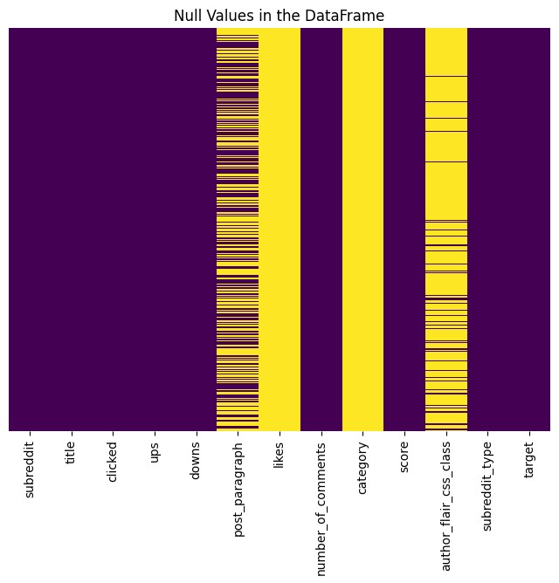
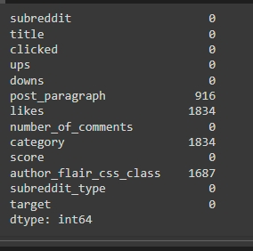
Data preprocessing
Check NAN values
Notes:
We also checked NAN values from the data in order to replace them with the null values

Slide 12
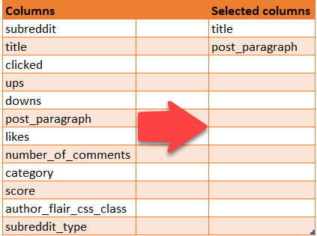
Data preprocessing
Selected columns
Before selected columns
12 columns
After selected columns
2 columns
Notes:
We decided to use 2 column to create our model which are title and post_paragraph that have relevant information retrieval to evaluate the importance of a word

Slide 13
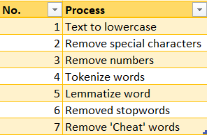

Data preprocessing
Data cleansing
Notes:
The following methods are employed In the data cleansing stage
which are …,…,…
We also do remove Cheat word from the sample data such as
['marvel', 'dc', 'comic','dccomics’] which could leads to data leak.

Slide 14

Encoding Data
‘Column title’ and ‘Post paragraph’ by
using technique:
Data encoding
CountVectorized
TfidfVectorizer
Assigned: 0=Marvel, 1=Dccomics
Notes:
Then, we encoded a collection of text documents to a matrix of token counts so that models can understand

Slide 15
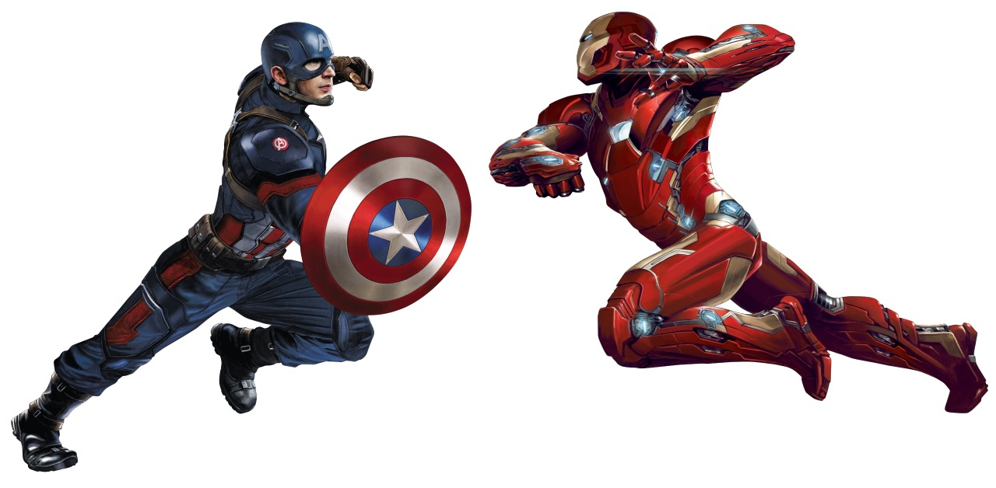
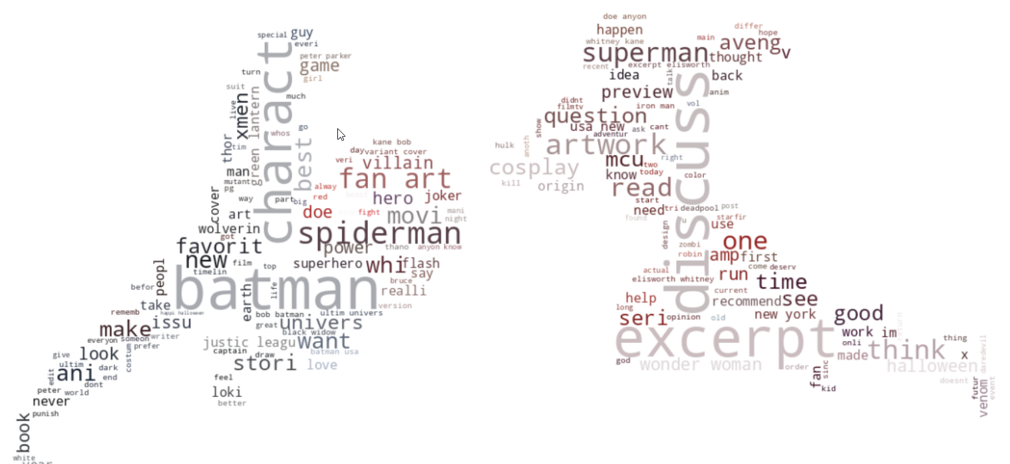

Notes:
This slid is presenting the most frequent words stated in our data set
We could see some character names belong to our targets Marvel and DC
Also, the common word that does not belong to our target such as Discuss and Excerpt etc
As the data comes from the thread sets which most people create for have some discussion of movies or some specific screens

Slide 16
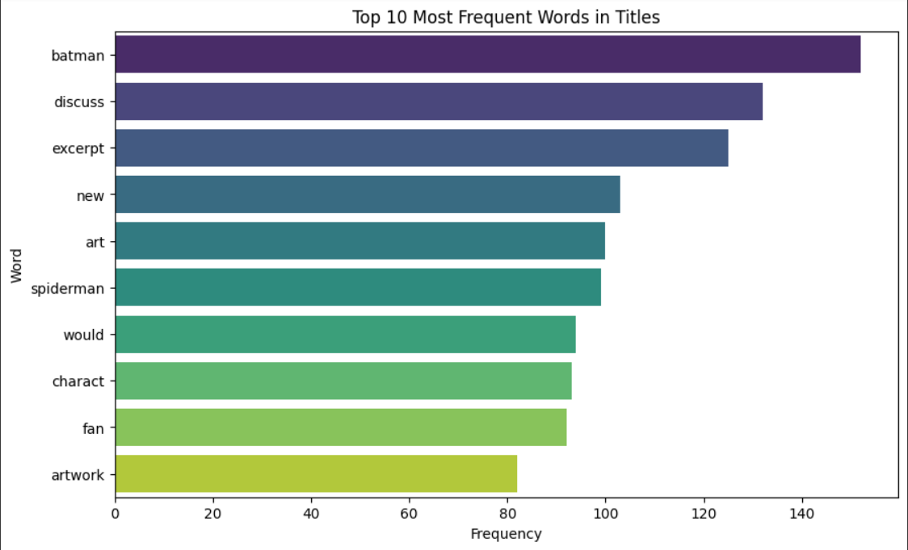
Notes:
Here are the top10 of word people seem interested the most in our target topics.

Slide 17
04
Modeling & Evaluation

Slide 18
What we found in modeling
Model: | Logistic Regression | RandomForest Classifier | ExtraTrees Classifier | NaiveBayes
Vectorization: | CountVectorize | CountVectorize | CountVectorize | CountVectorize
CV Folds: | 5 | 5 | 5 | 5
Train accuracy: | 1.00 | 1.00 | 1.00 | 0.98
Test accuracy: | 0.89 | 0.90 | 0.90 | 0.91
Test Macro F1: | 0.89 | 0.90 | 0.90 | 0.91
Notes:
At this stage, I have created 4 types of model for classification
Which are Logis, Randam, Extra and Naïve
With CountVectorizer teachnique
We could found that the Naïve did the best score in Macro F score with 0.91
Meanwhile, the others performed well in training and got 1 score for training accuracy
But get less score in testing.

Slide 19
What we found in modeling
Model: | Logistic Regression | RandomForest Classifier | ExtraTrees Classifier | NaiveBayes
Vectorization: | TF-IDF | TF-IDF | TF-IDF | TF-IDF
CV Folds: | 5 | 5 | 5 | 5
Train accuracy: | 0.98 | 1.00 | 1.00 | 0.99
Test accuracy: | 0.91 | 0.90 | 0.92 | 0.90
Test Macro F1: | 0.91 | 0.90 | 0.92 | 0.90

Slide 20
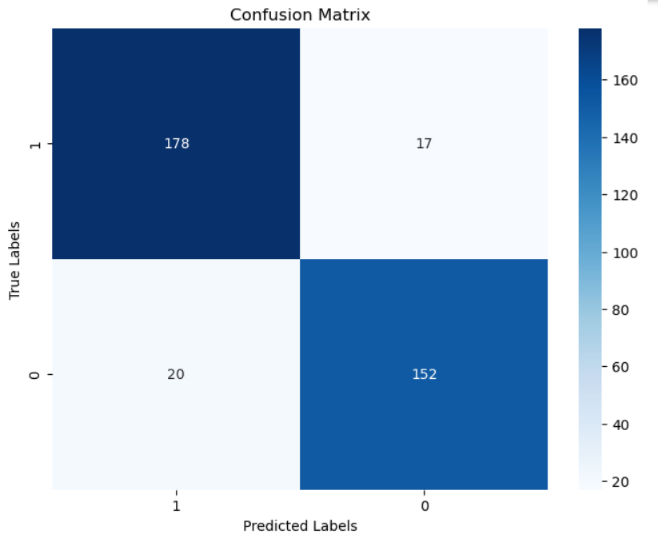
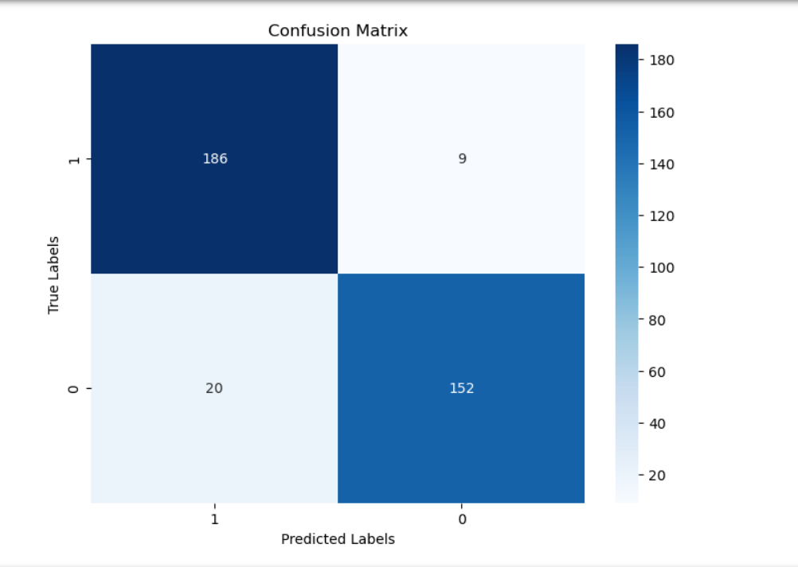
What we found in modeling
CountVectorized +
ExtraTrees Classifier
TF-IDF +
ExtraTrees Classifier

Slide 21
GridSerchCV TF-IDF Vectorizer
GridSerchCV ExtraTrees Classifier
Best Parameters:
{'tfidf__max_features': 10000,
'tfidf__ngram_range': (1, 2),
'tfidf__norm': 'l1’,
'tfidf__smooth_idf': True,
'tfidf__sublinear_tf': True,
'tfidf__use_idf': True}
Best Parameters:
{'clf__max_depth': None, 'clf__min_samples_leaf': 2, 'clf__min_samples_split': 2, 'clf__n_estimators': 50}

Slide 22
Model: | ExtraTrees Classifier | ExtraTrees Classifier
Vectorization: | TF-IDF | TF-IDF
Auto-tunning | YES | NO
CV Folds: | 5 | 5
Train accuracy: | 1.00 | 1.00
Test accuracy: | 0.88 | 0.92
Test Macro F1: | 0.88 | 0.92
Notes:
Seems like the tunned model is significantly overfit
Because 2 model have train accuracy score at the same
But it has test macro score differently which are 0.88 and 0.92
So we decided to use model with ExtraTrees classifier and TF-IDF feature extraction technique to integrate into our inventory management system

Slide 23
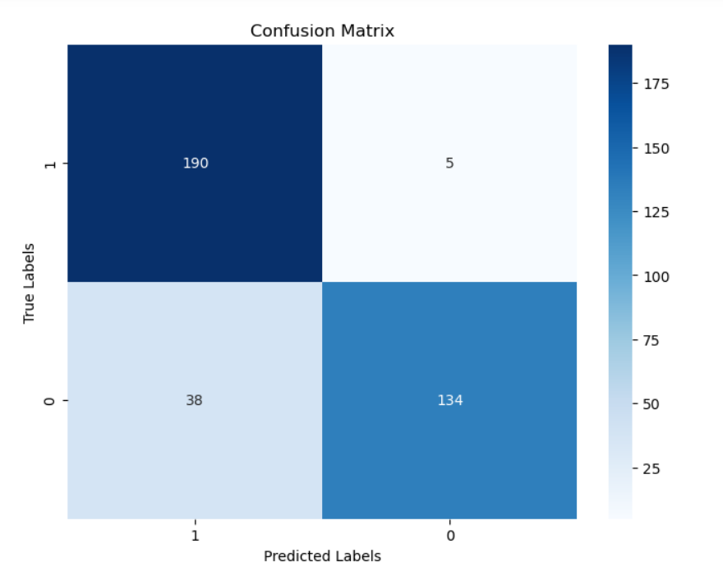
Automation Fine-tuning TF-IDF + ExtraTreesClassifier
(Model tuned)
TF-IDF + ExtraTrees Classifier
(Model not tuned)
TF-IDF + ExtraTrees Classifier
Notes:
Tunned has significantly high number incorrect

Slide 24
05
Error analysis

Slide 25
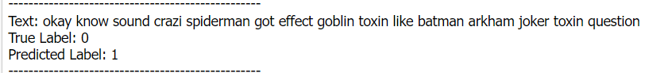
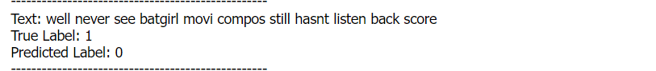
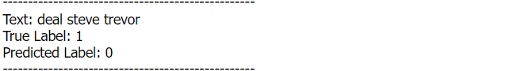
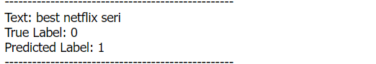
Error Analysis

Slide 26
06
Conclusion & Recommendation

Slide 27
Conclusion
In conclusion, the implementation of the comic-themed toy classification model has significantly enhanced our toy shop's inventory management system. The integration of the pre-existing model for Marvel and DC comics has proven to be a valuable asset, automating the classification process and improving overall efficiency.

Slide 28
Recommendations
Continuous Model Training: Given the dynamic nature of the toy market and the introduction of new comic-themed characters, it is recommended to periodically retrain the classification model. Regularly updating the model with new data will ensure its accuracy and relevance over time (CI/CD).

Slide 29
Limitation
Expand Feature Set: Consider expanding the feature set used by the model. This could include incorporating additional attributes such as toy dimensions, materials, and popularity trends (if any). Expanding the feature set may further improve the model's ability to distinguish between Marvel and DC characters.

Slide 30
Thank you

